Slide 1
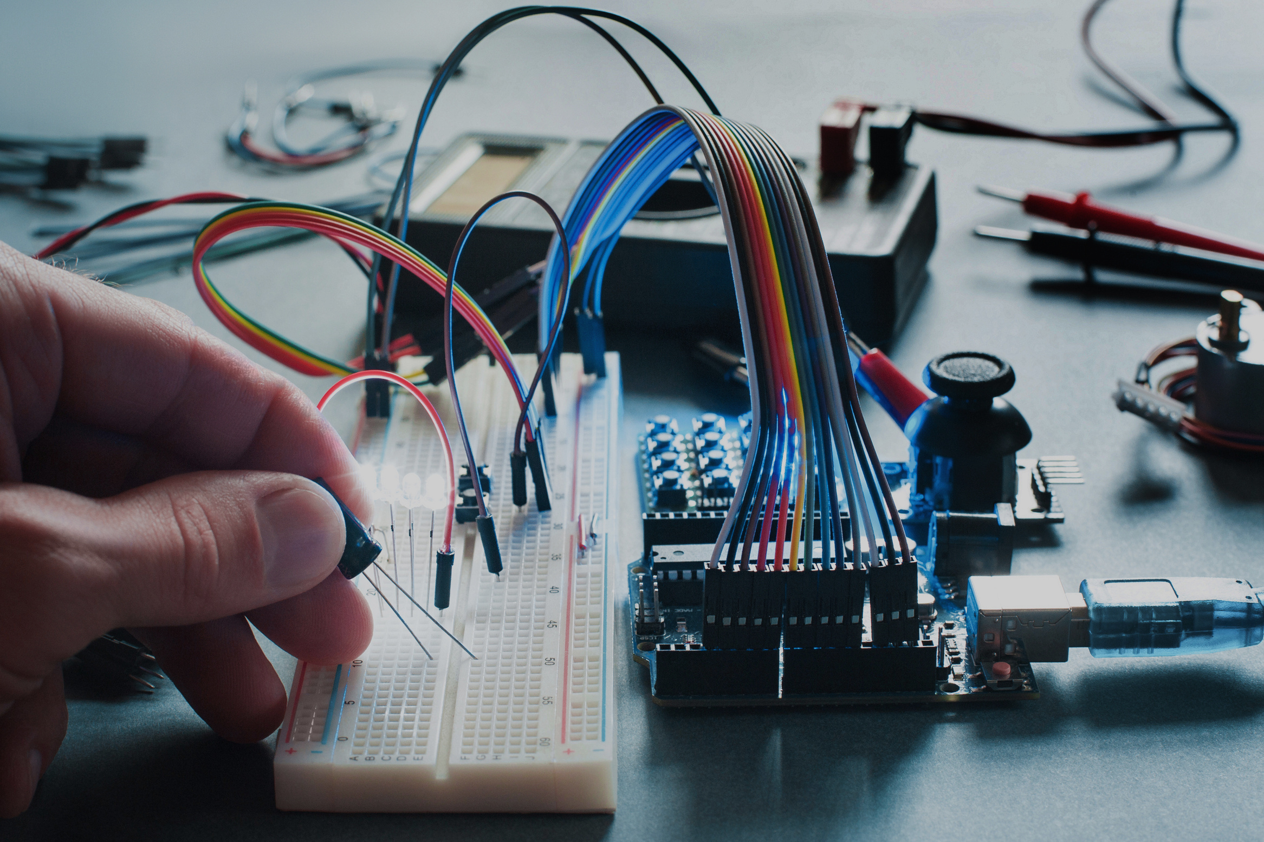
Calculator using Atmega 32
Instructor : N.M.Thanh

Slide 2

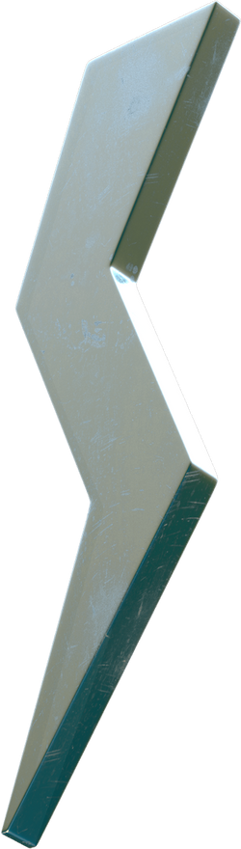
Introduction
Table of content
Components
Schematic circuit
PCB circuit

Slide 3
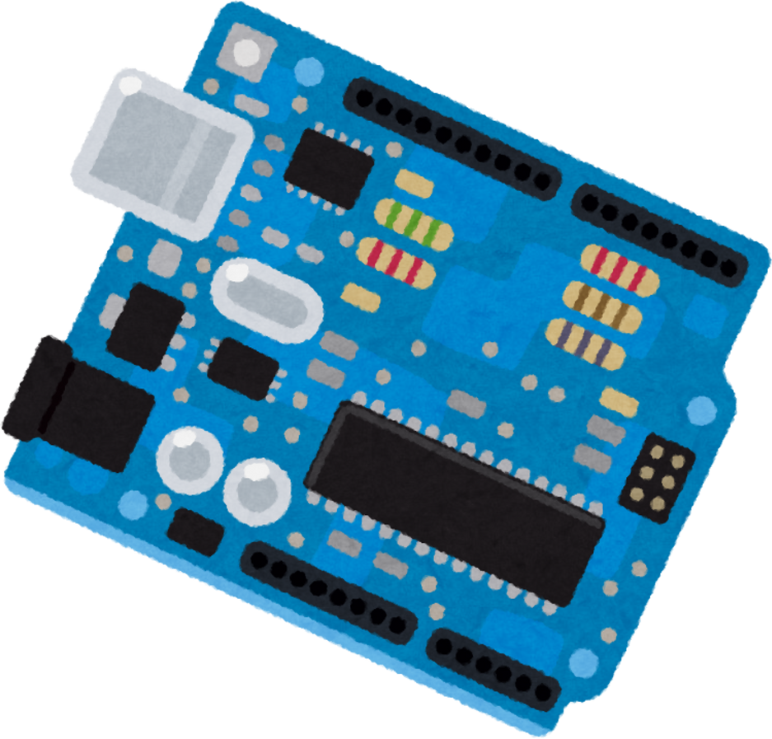
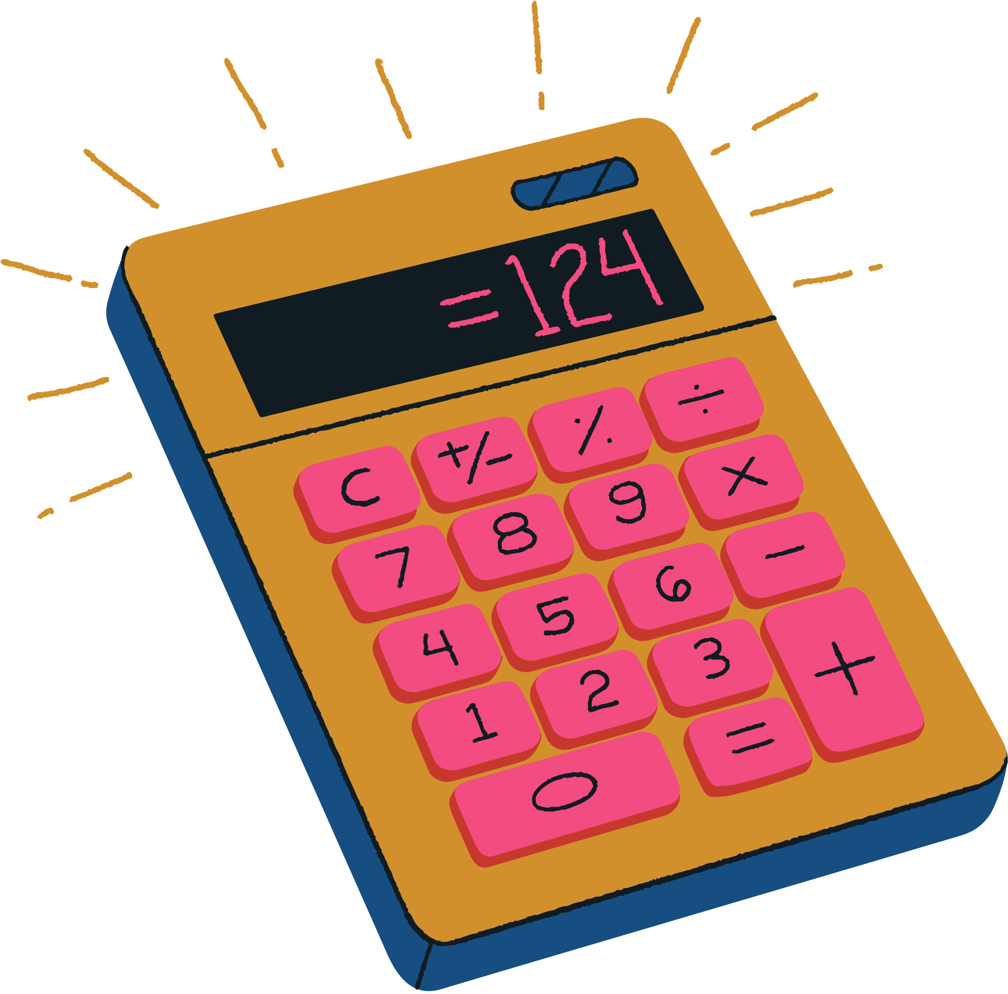

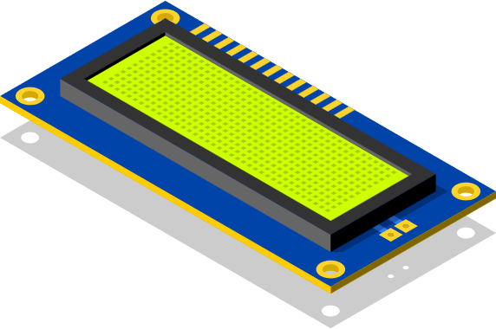
Introduction
The basic calculator using Atmega32 with assembly code embbeding into Atmega32

Slide 4
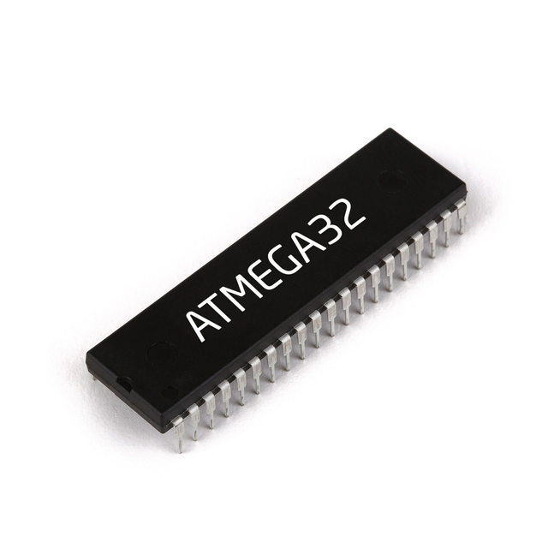
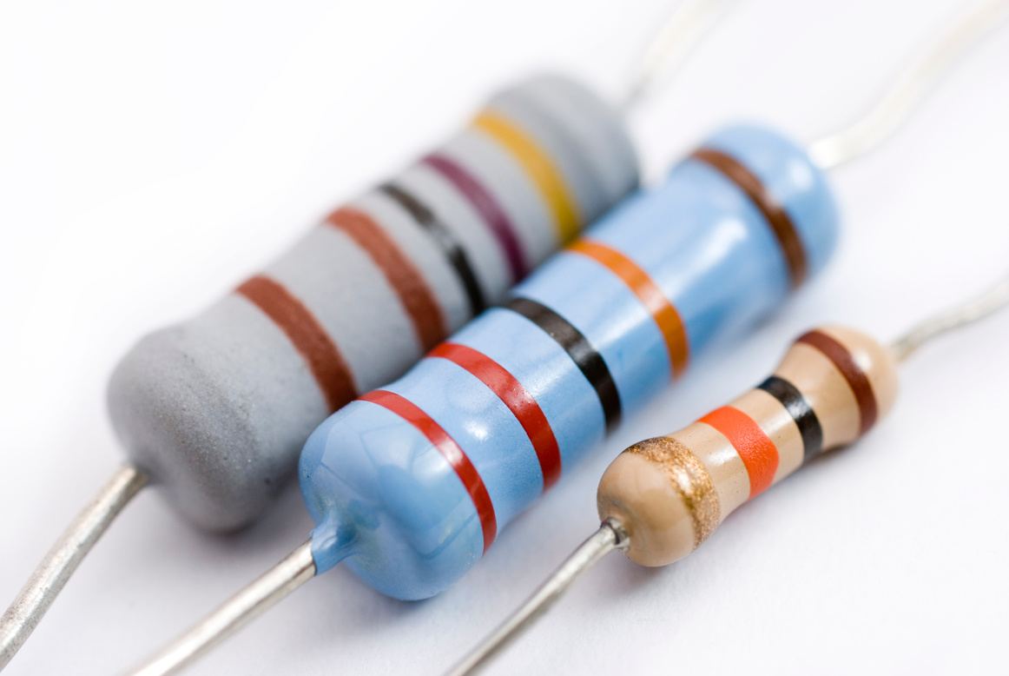
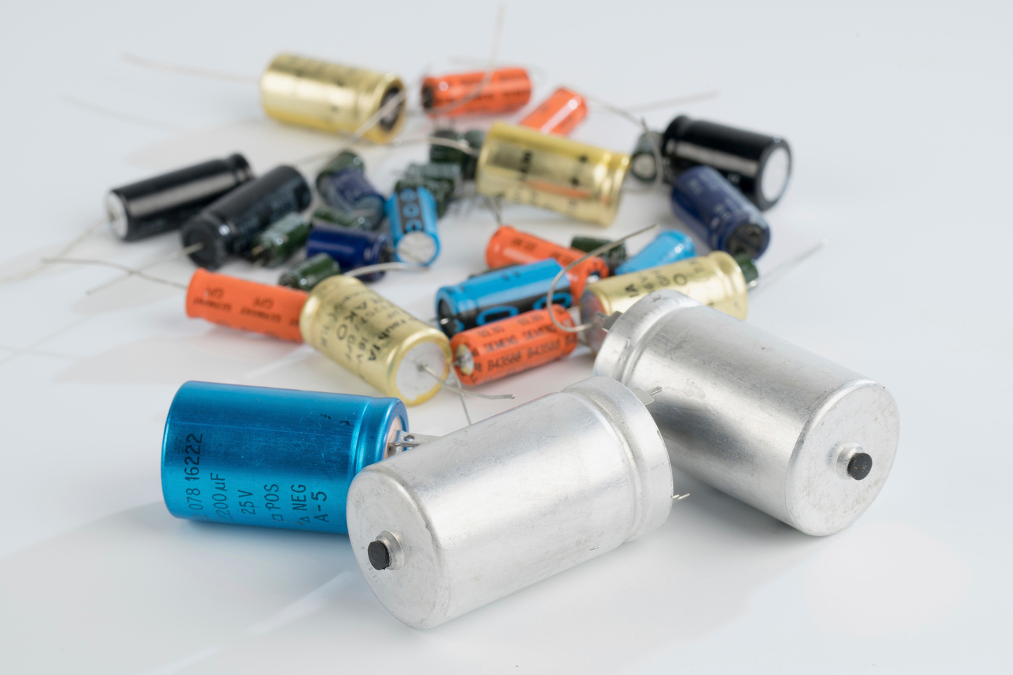
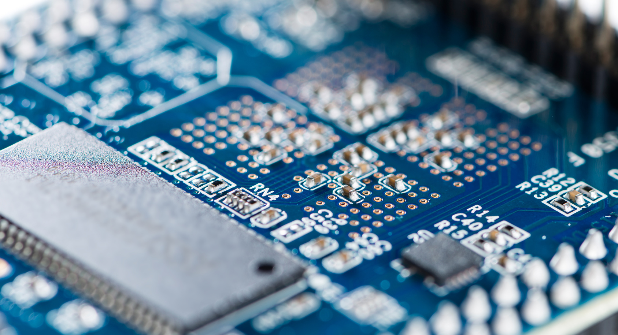
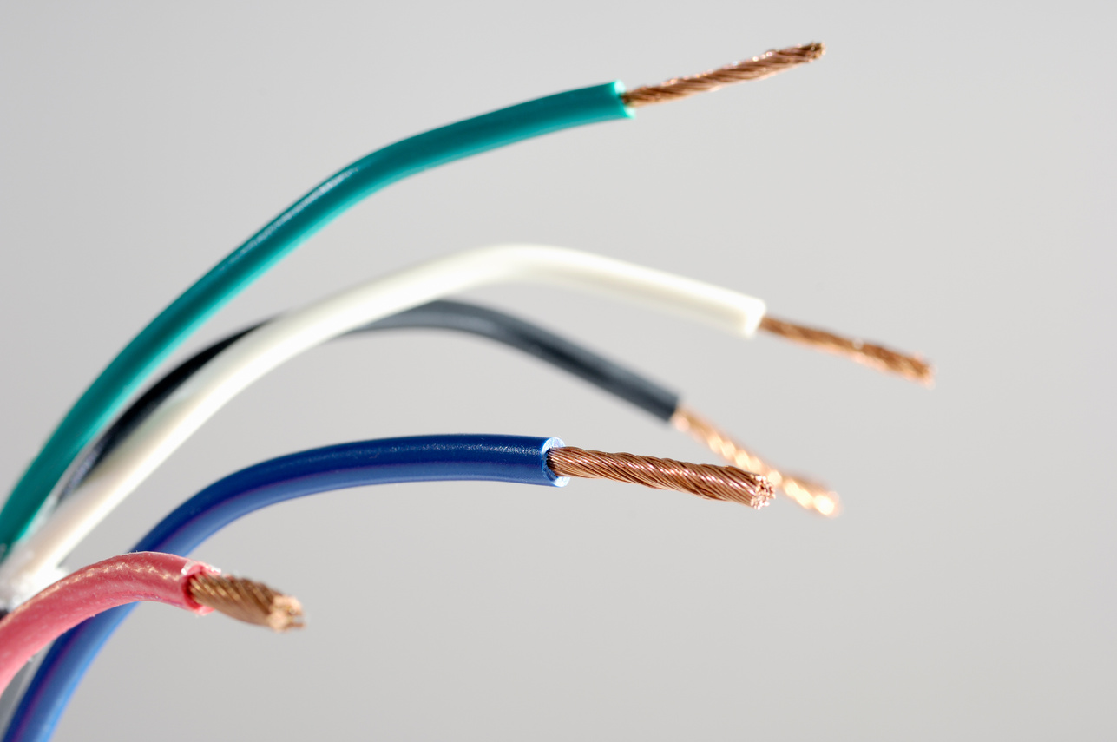
Components
CAPACITOR
ATMEGA 32
RESISTOR
CAPACITOR
PCB
WIRE

Slide 5
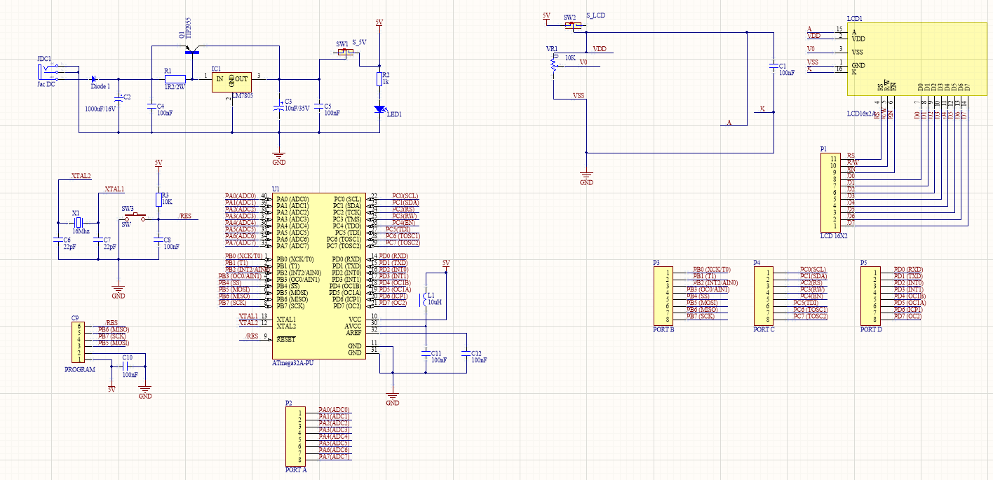
Schematic circuit

Slide 6
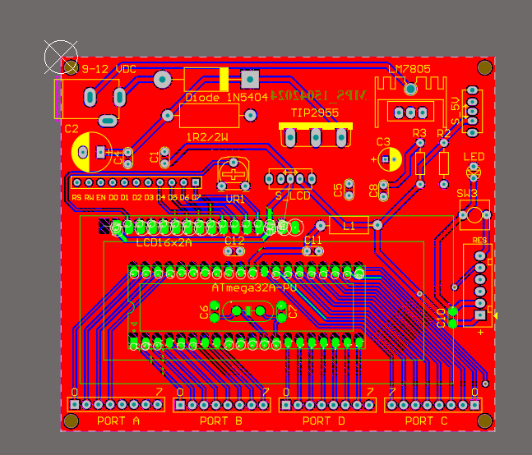
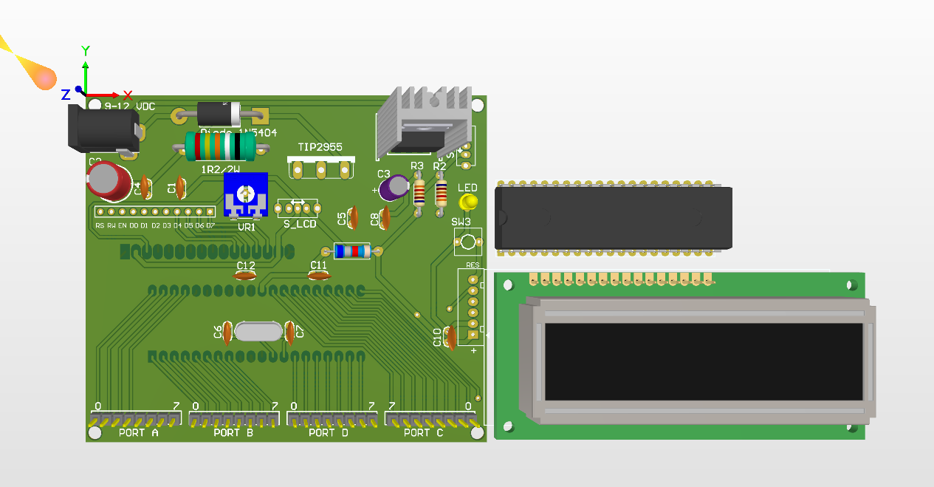
PCB circuit

Slide 7
THANK YOU FOR LISTENING

